Slide 1


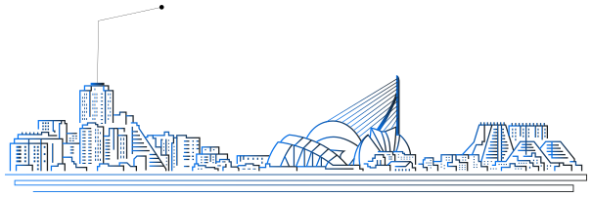
organized by:
with the support of:
ABSTRACT TITLE
COMPANY LOGO
Author
st
CONGRESS
DETECTION, MEASUREMENT AND CONTROL OF EMERGING RISKS

Slide 2
INDEX
01
Warm Welcome
07
Color Palette
02
About Us
08
Logo Usage
03
Our Values
09
Typography
04
We are in Numbers
10
Our Gallery
05
Moodboard Set
11
The Team
06
Our Services
12
Connect with Us
st
CONGRESS

Slide 3
TITLE
Subtitle
Subtitle
Over the years, technology has been the nerve of our
daily life. It revolutionized how the world works with
amazing tools and resources. As one of the leading
supports of today's technology, it is an honor for us to
always give the best services and provide innovative
products at your fingertips.
Over the years, technology has been the nerve of our
daily life. It revolutionized how the world works with
amazing tools and resources. As one of the leading
supports of today's technology, it is an honor for us to
always give the best services and provide innovative
products at your fingertips.
st
CONGRESS

Slide 4
SECTION TITLE
st
CONGRESS

Slide 5
TITLE
Subtitle
Subtitle
Subtitle
Over the years, technology has been the nerve of our
daily life. It revolutionized how the world works with
amazing tools and resources. As one of the leading
supports of today's technology, it is an honor for us to
always give the best services and provide innovative
products at your fingertips.
Over the years, technology has been the nerve of our
daily life. It revolutionized how the world works with
amazing tools and resources. As one of the leading
supports of today's technology, it is an honor for us to
always give the best services and provide innovative
products at your fingertips.
Over the years, technology has been the nerve of our
daily life. It revolutionized how the world works with
amazing tools and resources. As one of the leading
supports of today's technology, it is an honor for us to
always give the best services and provide innovative
products at your fingertips.
st
CONGRESS

Slide 6
Subtitle
Over the years, technology has been the nerve of our
daily life. It revolutionized how the world works with
amazing tools and resources. As one of the leading
supports of today's technology, it is an honor for us to
always give the best services and provide innovative
products at your fingertips.
IMAGE
st
CONGRESS

Slide 7
TITLE
Subtitle
Over the years, technology has been the nerve of our
daily life. It revolutionized how the world works with
amazing tools and resources. As one of the leading
supports of today's technology, it is an honor for us to
always give the best services and provide innovative
products at your fingertips.
IMAGE
st
CONGRESS

Slide 8
organized by:
with the support of:
THANK YOU
st
Name and Last Name
CONGRESS
AUTHOR
PHOTO
Position
DETECTION, MEASUREMENT AND CONTROL OF EMERGING RISKS
Company
Email

